Slide 1
JavaScript
Lecture 2

Slide 2
Understanding Events
What is an Event ?
Specific circumstance monitored by JavaScript and that your script can respond to in some way
Allows users to interact with Web pages
Common events: actions users perform
Can also monitor events not resulting from user actions

Slide 3

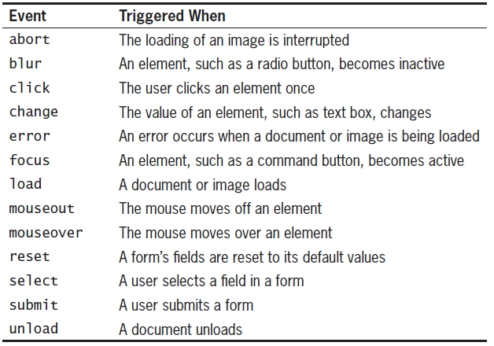
JavaScript events

Slide 4
Understanding Events (cont’d.)
Working with elements and events
Events: associated with HTML elements
Event handler
Code that executes in response to a specific event
JavaScript code for an event handler
<element event_handler = “javascript code”>
Included as an attribute of the element that initiates the event
For example:
<input type = "button" onclick = "window.alert('you clicked the button');">
Event handler names are the same as the event itself, plus a prefix of “on”
Code is contained within the quotation marks following the name of the event handler
Event handler names are case sensitive and must be all lowercase letters

Slide 5
Understanding Events (cont’d.)
Take note of the quotations on the previous slide. Can you explain why we need both single and double quotations.
The window.alert() method is the only statement being executed in the previous example.
You can however include multiple JavaScript statements in an event handler as long as semicolons separate the statements.
<input type = "button" onclick = “var message = ‘you clicked me’; window.alert(message);">

Slide 6
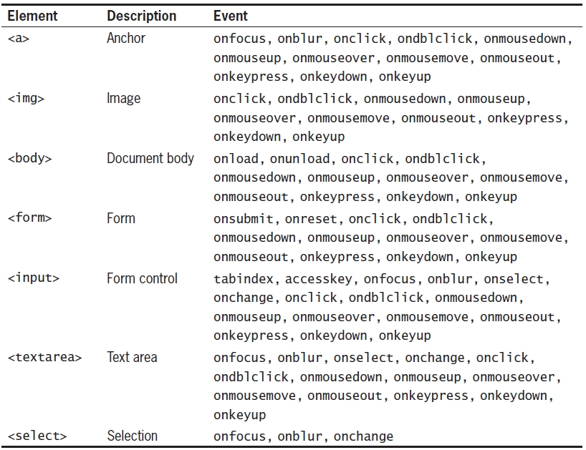
Understanding Events (cont’d.)
HTML elements and their associated events

Slide 7
Understanding Events (cont’d.)
Referencing Web page elements
You can use JavaScript to access any element on a web page
Append element’s name to the name of any elements in which it is nested and always start with the document object
Specific element properties are also appended to the element name
document.invoice.salesTotal.value=12;
The above example has a form called invoice (set using the name property) which in turn has a textbox called salesTotal (again using the name property). The property value is used to set or retrieve the value entered into the field. The entire reference has to begin with the document object
As with events properties also differ between elements

